Slide 1

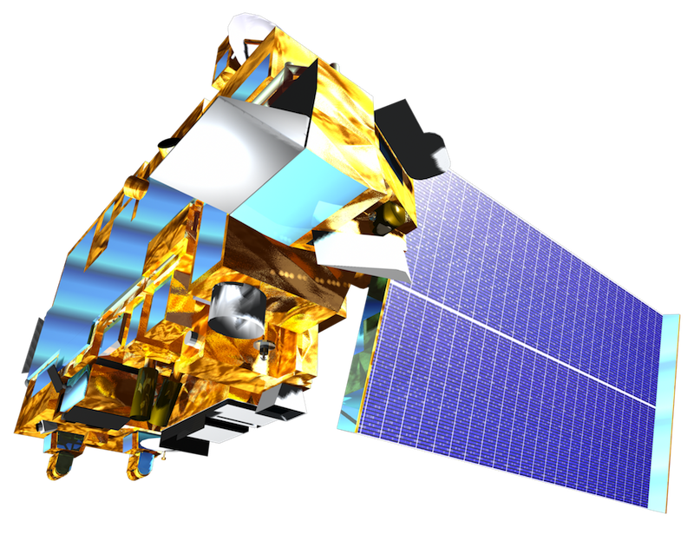
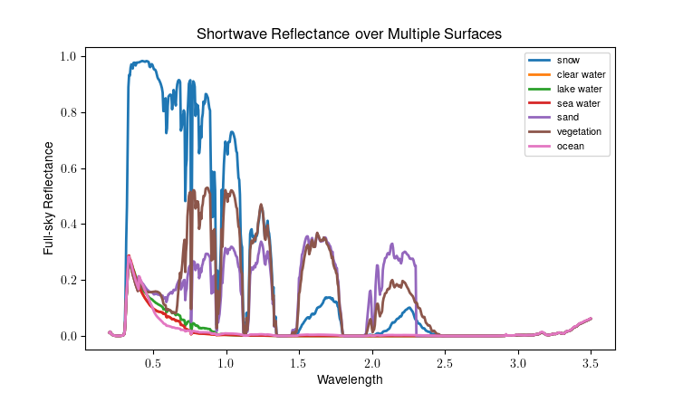
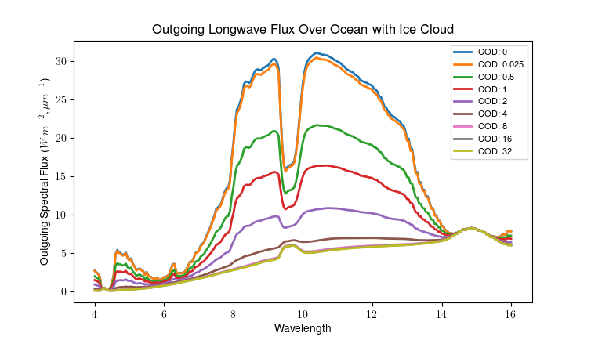

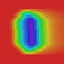
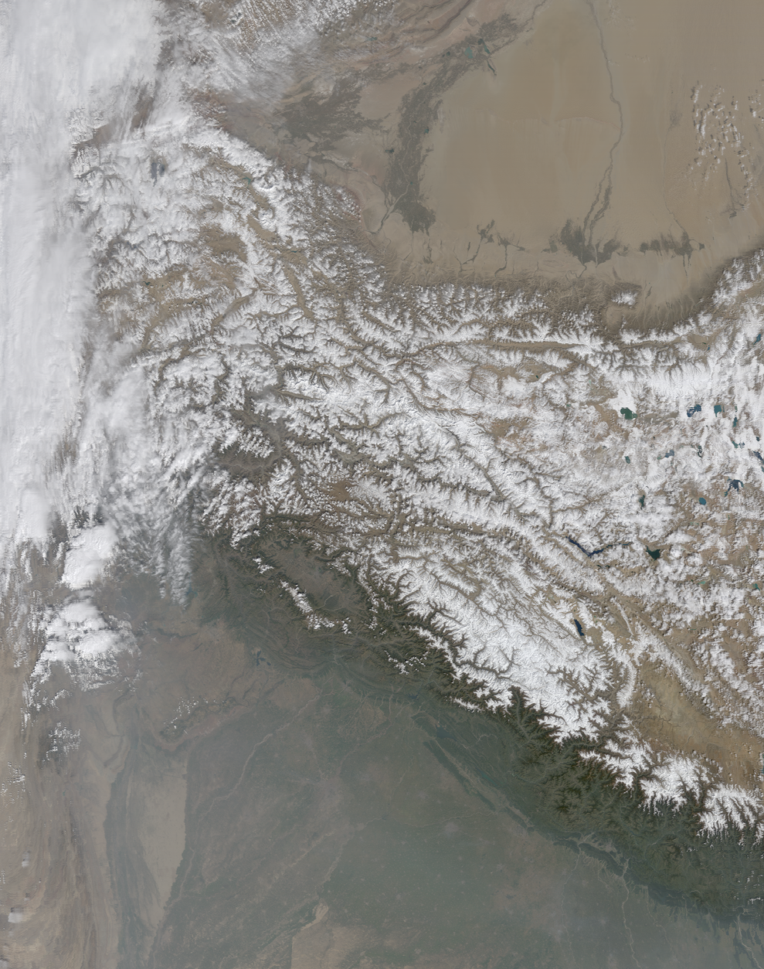
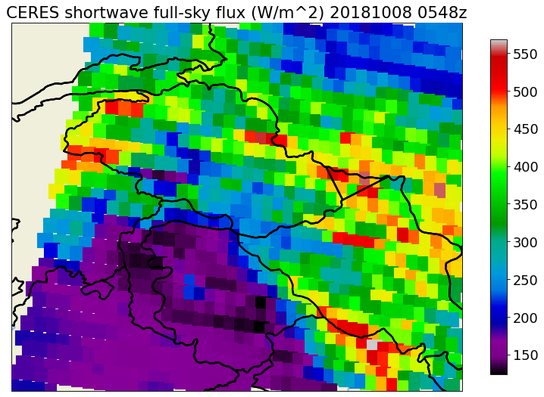
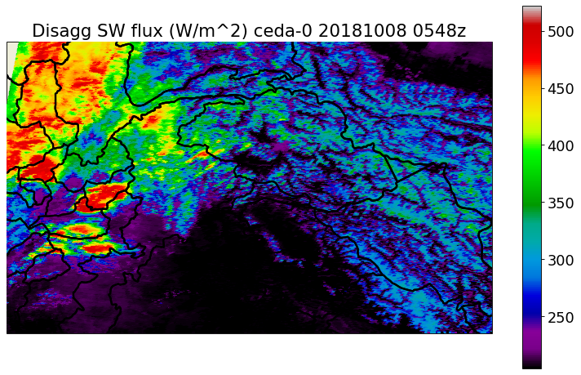
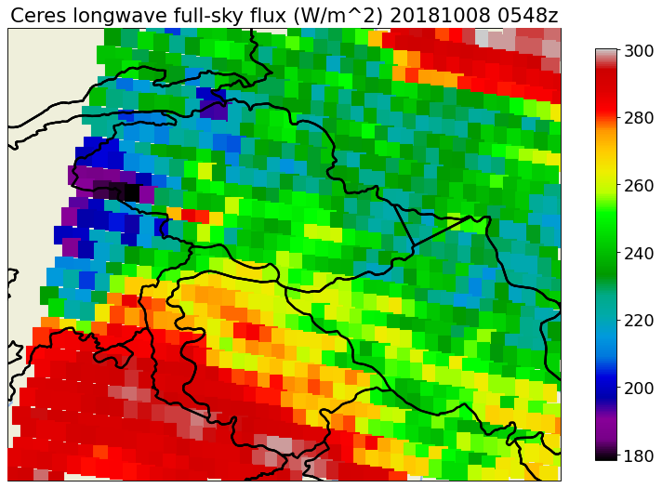
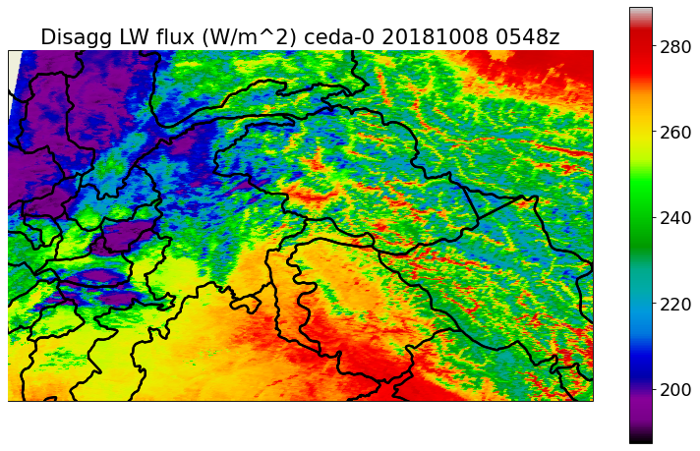
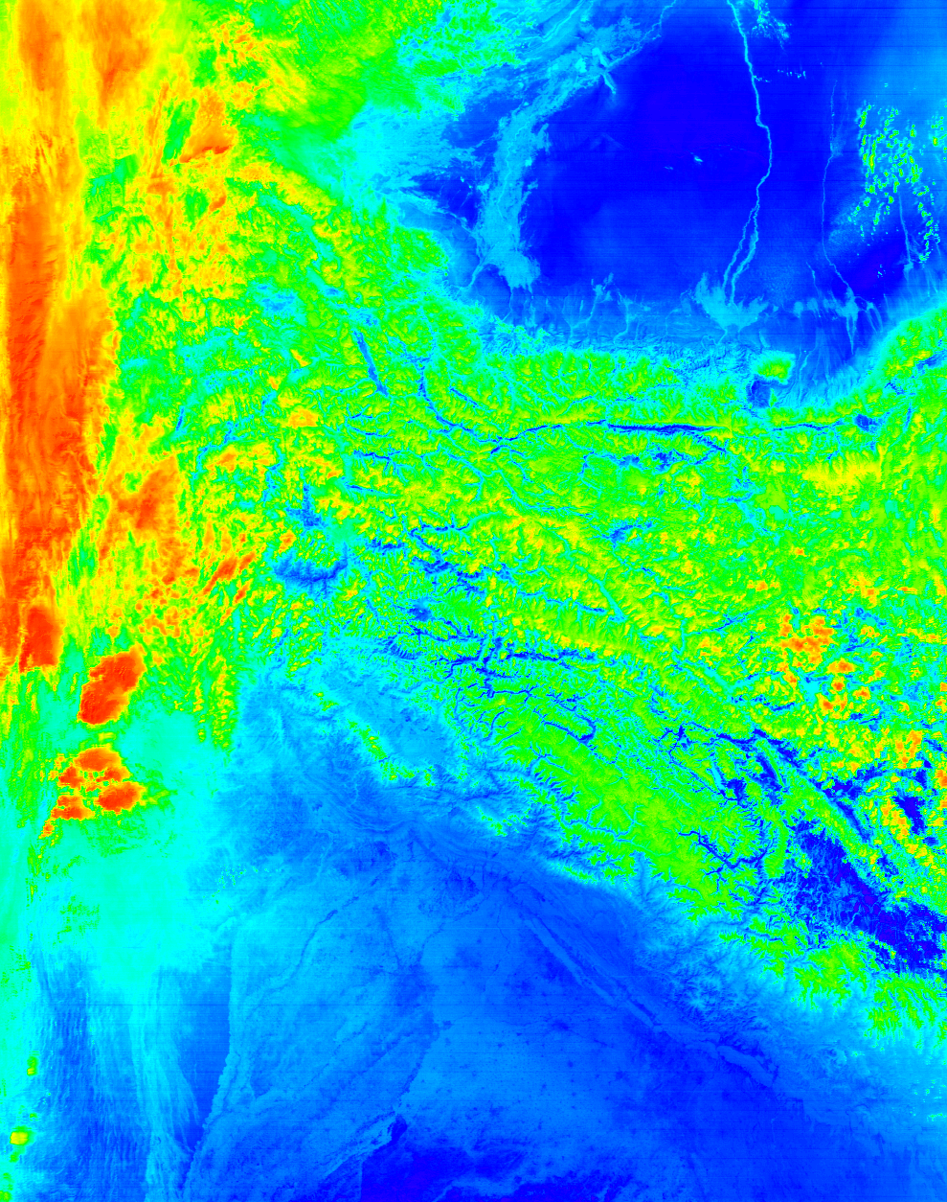
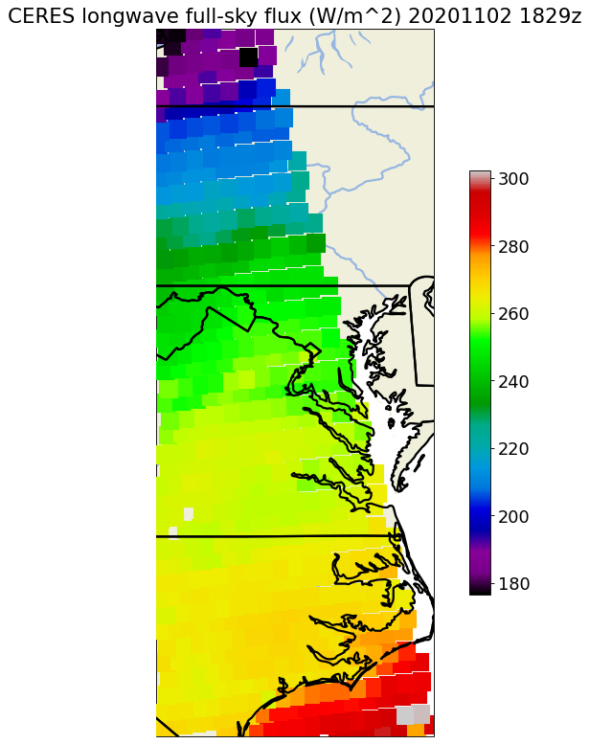
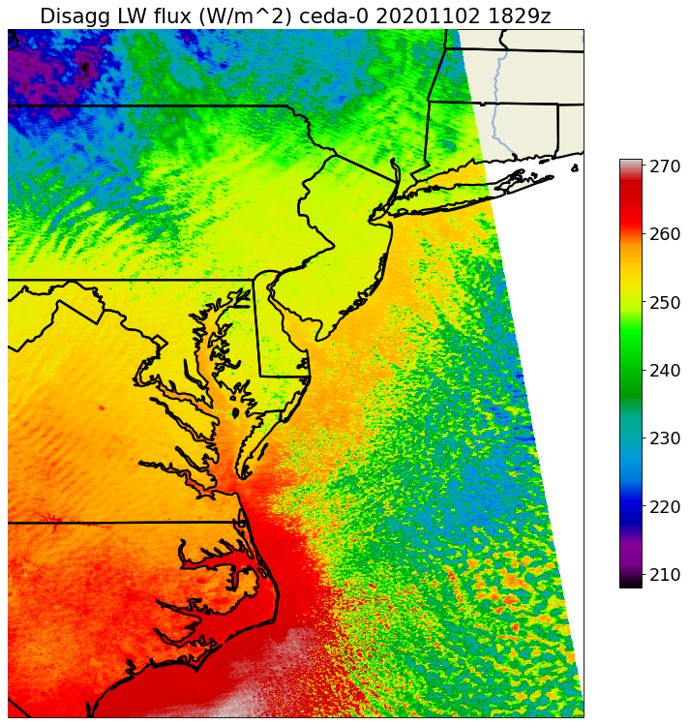
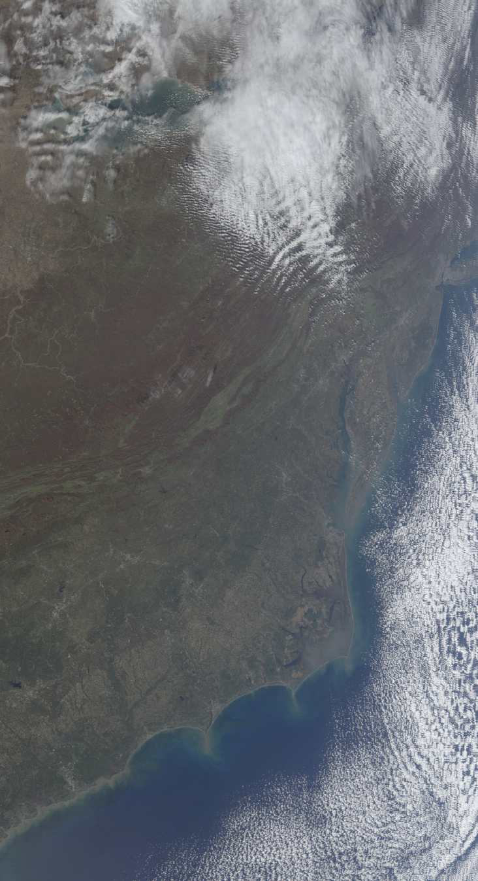
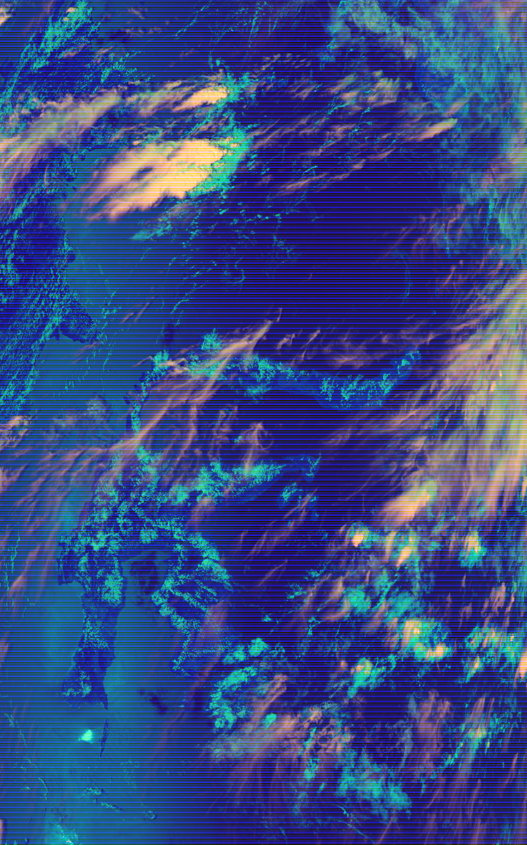
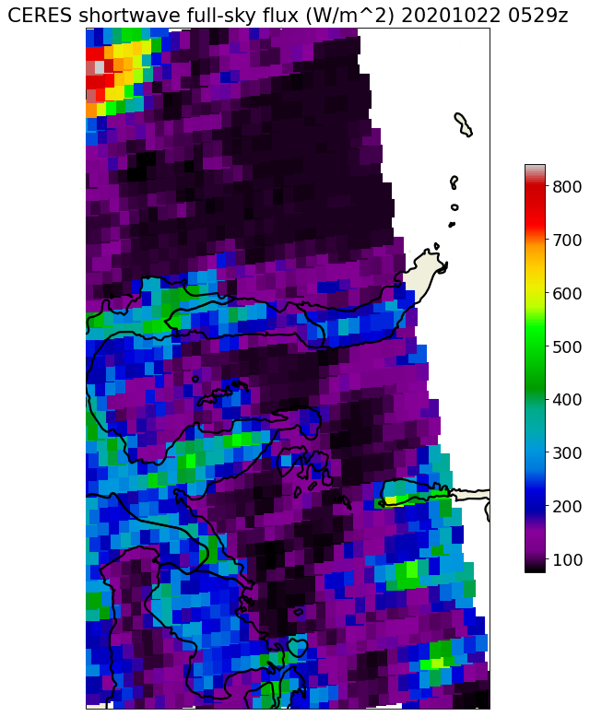
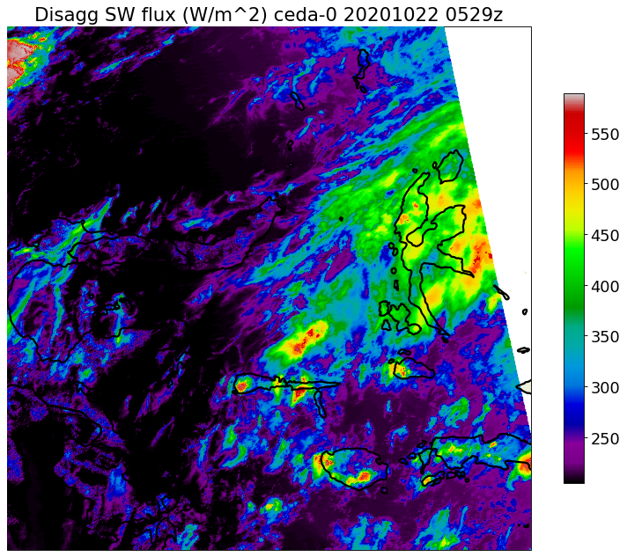
A Deep Learning Approach to Estimate CERES Broadband
Flux at 1km Resolution with MODIS Radiances
Solar Zenith
Angle
Mitchell Dodson (mtd0012@uah.edu), Sean Freeman - University of Alabama in Huntsville
Motivation
The CERES instrument on the Earth Observing System (EOS) Terra and Aqua polar-orbiting satellites measures the total radiation leaving the surface in the entire shortwave and longwave spectral ranges. It plays a pivotal role as a long-term direct observatory of Earth’s energy budget (boasting a 25+ year data record), and provides a widely-recognized validation standard in land surface, atmospheric, and climate modeling. Nonetheless, its coarse resolution (~16x24km at NADIR) is a limiting factor.
The MODIS instrument (also on the EOS platforms) is a radiometer with 36 narrow spectral bands in visible, near-infrared, and infrared ranges, at 1km resolution. Since their observations are exactly coincident, and should be strongly spectrally correlated, MODIS pixels can inform estimates of the full-sky fluxes from the CERES-SSF product.
In order to use the CERES observations as a prediction target, the weighted sum of model predictions must be calculated during training with the point spread function (PSF).
The subsequent model acts as a pixel-wise data-driven radiative transfer model, implicitly learning surface properties relevant to flux predictions. Predictions can be studied in isolation using bulk statistical techniques, or utilized to evaluate the flux from kilometer-scale features (cities, inland water bodies, mountain snow, and small clouds).
Model estimates of shortwave and longwave radiative flux over different surfaces (using SBDART). Typical radiative transfer model outputs are discrete, and based on a-priori assumptions about the surface characteristics. Narrow-band satellite observations provide information about surfaces’ reflectivity, emissivity, and anisotropy, so in a data-driven model they are useful predictors for the full-sky flux.
Outgoing Flux, Radiance, and Radiative Transfer Modeling
CERES SW
CERES LW
Viewing Zenith Angle
MODIS
Radiances
In the visible, NIR, and infrared ranges,
MODIS provides “point observations,”
CERES measures integrated totals.
Point Spread Function
16km
24km
Numerical Modeling Approach
Data-driven Modeling Approach
Schematic diagram of the co-location of CERES and MODIS observations on EOS satellites Terra and Aqua.
Each CERES pixel directly overlaps ~400 MODIS pixels
with contributions defined by point spread function
A-Priori Scene
Features
Radiation
Model
Discrete Spectral
Radiance Estimates
Observed Spectral
Radiances
Neural
Network
Continuous Full-sky
Flux Estimates
Discrete
Viewing Geometry
Discrete Full-sky
Flux Estimates
Satellite
Viewing Geometry
Arbitrary Scene Feature
Estimates (in future)
Architecture
Divergence:
D = (P - F_{C})² + w R²
R = Regularization
layer activation
Objective
Given narrow band MODIS radiances and viewing geometry, train a simple deep learning model to estimate the total top-of-atmosphere outgoing shortwave and longwave radiative flux observed by CERES by making pixel-wise predictions at MODIS’ 1km resolution, and applying the PSF to aggregate them during training.
The model should (1) be lightweight enough to run on large MODIS granules with a CPU, (2) use the CERES point spread function to evaluate predictions during training, and
(3) preserve locality (pixel-wise or close) so its radiative properties can be directly investigated in terms of a small number of incident MODIS pixels.
Hindu Kush Himalayan Mountains
Clouds, lowland desert surfaces, mountain top snow, vegetation
Predicted P_{SW} P_{LW}
Shape: (B,F_{C})
True color RGB
Taklamakan Desert
average
SW
Aggregated SW/LW
(PSF applied to latent)
Shape: (B,1,1,F_{C})
LW
SW
LW
Aggregated SW/LW
(PSF applied to pred.)
Shape: (B,1,1,F_{C})
(Reg Layer)
(Reg Layer)
×L_{D} SW Decoder
(1D Conv)
×L_{D} LW Decoder
(1D Conv)
PSF
(MultSum P)
Sharpened SW/LW
Shape: (B,W,W,F_{C})
Z
G
SW
LW
Pakistan
Agg. Latent vector Z
Shape: (B,1,1,F_{L})
(Reg Layer)
(Reg Layer)
India
PSF
(MultSum P)
×L_{D} SW Decoder
(1D Conv)
×L_{D} LW Decoder
(1D Conv)
Longwave Prediction
Hotan and Yarkant Rivers, surrounding crop land
Z
Z, G
Methodology
Acquire EOS-Aqua and EOS-Terra overpasses in 6 regions: NEUS, Alaska, Indonesia, SEUS, Himalayas, Amazon. (used more than 2,600 overpasses total).
Co-locate CERES footprints and simultaneous MODIS observations.
Use viewing geometry to calculate PSF for each overlapping CERES/MODIS tile.
Train a 1D CNN to make pixel-wise flux predictions, which are aggregated in the loss function using the calculated PSF.
Evaluate in a variety of scenes with the PSF set to 1 during inference.
Thin Cirrus
CERES Domain
Latent grid Z
Shape: (B,W,W,F_{L})
Z
CERES Domain
Strongly differentiates mountain snow from colder cloud tops
×L_{E} Encoder
(1D Conv)
Copy along axes
M
View Geometry G
Shape: (B,1,1,F_{G})
MODIS pixels M Shape: (B,W,F_{M})
Indus river,
geologic layering
Future Work
Regional statistical analysis of predictions, and evaluation with respect to MODIS L2 products (aerosol/cloud optical depth, LST, etc).
Incorporate textural information by expanding first convolution layer to 3x3 and 5x5; investigate interpretability of activations.
Evaluate physical integrity of network by comparing flux outputs directly to RT models.
Improve geometric compactness of latent space outputs by using them to parameterize variational distributions before decoding.
Apply the same technique to the VIIRS instrument on Suomi-NPP and NOAA series satellites (which also have CERES instruments).
Adapt flux models to GOES geostationary data.
US East Coast
Coastal temperature gradient, high and low clouds, gravity waves
Urban heat island
(Gujranwala, Pakistan)
Southeast Asia / Oceania
Tropical sun glint, fine cirrrus over land and ocean
CERES LW Flux (W/m^2)
Day cloud phase RGB
Captures very thin cirrus
CERES Domain
Day cloud phase RGB
Taller and deeper ice clouds
Sulawesi, Indonesia
CERES Domain
Sub-visible
gravity waves?
Low glaciating maritime clouds
Off-coast longwave
maximum is captured
No sun glint

